Slide 1

Lecture 8
ArrayList

Slide 2
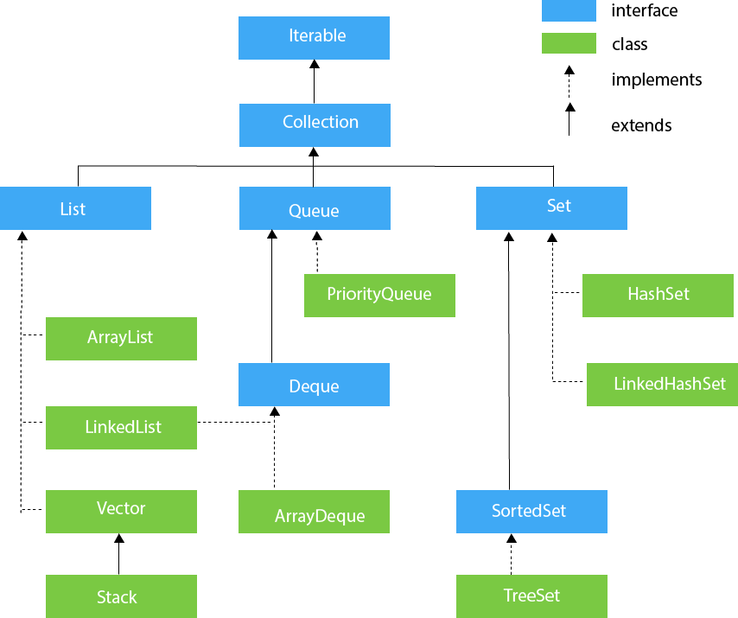

Slide 3
Java ArrayList
The ArrayList class is a resizable array, which can be found in the java.util package.
import java.util.ArrayList; //
import the ArrayList class ArrayList<String> cars = new ArrayList<String>(); // Create an ArrayList object

Slide 4
Add Item
import java.util.ArrayList;
public class Main {
public static void main(String[] args) {
ArrayList<String> cars = new ArrayList<String>();
cars.add("Volvo");
cars.add("BMW");
cars.add("Ford");
cars.add("Mazda");
System.out.println(cars);
}
}
Access an Item
cars.get(0);

Slide 5
Change an Item
cars.set(0, "Opel");
Remove an item
cars.remove(0);
Clear all item
cars.clear();

Slide 6
ArrayList Size
cars.size();
Loop Through an ArrayList
public class Main {
public static void main(String[] args) {
ArrayList<String> cars = new ArrayList<String>();
cars.add("Volvo");
cars.add("BMW");
cars.add("Ford");
cars.add("Mazda");
for (int i = 0; i < cars.size(); i++) {
System.out.println(cars.get(i));
}
}
}

Slide 7
For Each
public class Main {
public static void main(String[] args) {
ArrayList<String> cars = new ArrayList<String>();
cars.add("Volvo");
cars.add("BMW");
cars.add("Ford");
cars.add("Mazda");
for (String i : cars) {
System.out.println(i);
}
}
}

Slide 8
Sort Array
import java.util.ArrayList;
import java.util.Collections; // Import the Collections class
public class Main {
public static void main(String[] args) {
ArrayList<String> cars = new ArrayList<String>();
cars.add("Volvo");
cars.add("BMW");
cars.add("Ford");
cars.add("Mazda");
Collections.sort(cars); // Sort cars
for (String i : cars) {
System.out.println(i);
}
}
}

